Slide 1
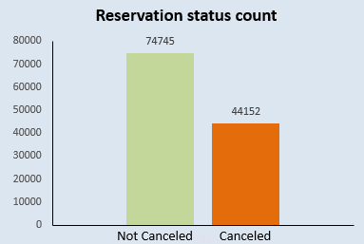
Analysis and Findings Report
Cancelation percentage in both hotels---------------------
0 0.628648 1 0.371352
Majority of bookings were not canceled, still some half of the bookings were canceled.
The provided bar graph illustrates the cancellation and non-cancellation percentages for reservations. It is evident that a substantial portion of reservations remains unaffected by cancellations. Notably, 37% of clients have chosen to cancel their reservations, and this has a noteworthy impact on the hotels' revenue.

Slide 2
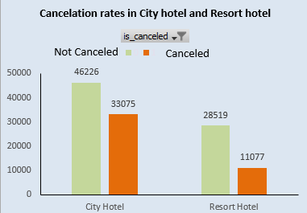
Most bookings were in city hotel
Cancelations in Resort hotel is less compared to city hotel.
In comparison to resort hotels, city hotels have more bookings.
It's possible that resort hotels are more expensive that those in cities.
=========================================

Slide 3
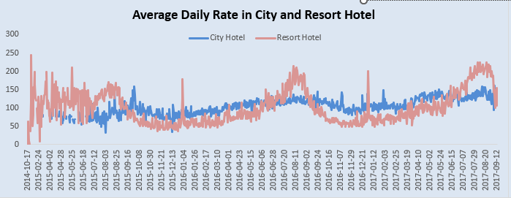
Prices of resort hotel are much higher.
Prices of city hotel do not fluctuate that much.
The line graph above shows that, on certain days the average daily rate for a city hotel is less than that of a resort hotel and on other days, it is even less.
It goes without saying that weekends and holidays may see a rise in resort hotel rates.
=========================================

Slide 4
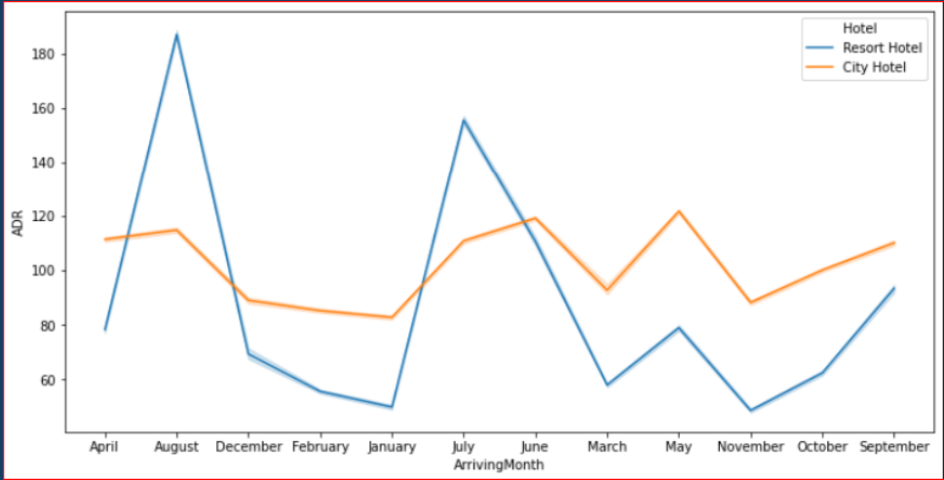
For Resort Hotel, ADR is more expensive during July, August & September and for City Hotel, ADR is slightly more during March, April & May.
=========================================

Slide 5
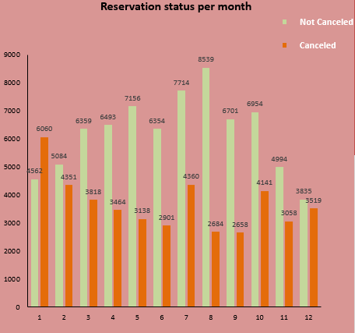
Most bookings were done in the month of May, June, July, August.
We've created a grouped bar graph to examine the months with the highest and lowest reservation levels based on their status. It's evident that the month of August stands out, having the highest numbers of both confirmed and canceled reservations. In contrast, January has the fewest confirmed reservations but the highest number of canceled reservations.
=========================================

Slide 6
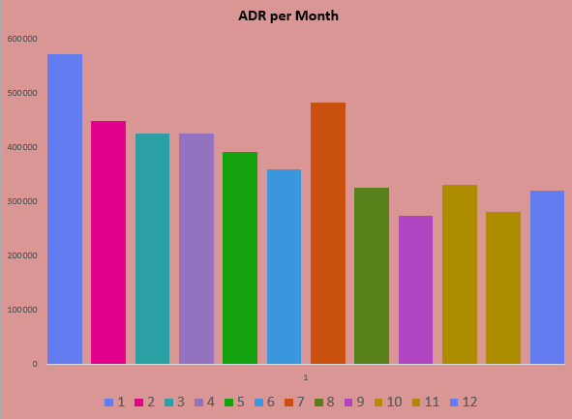
This bar graph illustrates that cancellations are most frequent when prices are at their highest and least common when prices are at their lowest. Consequently, the price of accommodation appears to be the primary factor influencing cancellations. =================================================

Slide 7
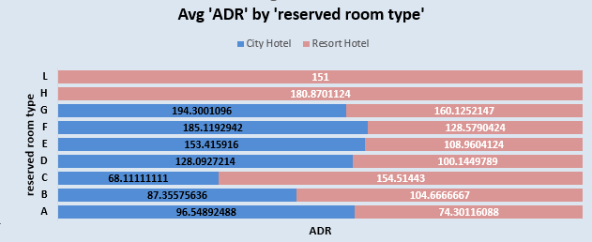
Both hotels have different room types and different meal arrangements. Seasonal factors are also important, So the prices varies a lot.
=================================================

Slide 8
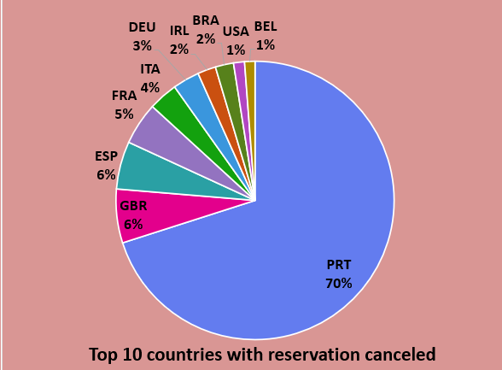
Now, let's examine which country experiences the highest number of canceled reservations. Portugal stands out as the top country with the highest number of cancellations.
=========================================

Slide 9
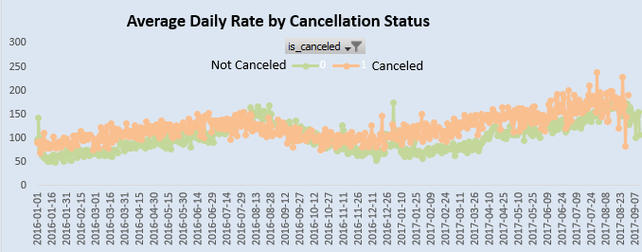
As seen in the graph, reservations are canceled when the average daily rate is higher than when it is not canceled. It clearly proves all the above analysis that the higher price leads to higher cancellation =============================================

Slide 10
Suggestions
• Increasing prices are associated with a higher rate of cancellations. To mitigate reservation cancellations, hotels could refine their pricing strategies by offering reduced rates for specific locations and providing discounts to customers.
• We also realise that the high rate of cancellations can be due high no deposit policies.
• The resort hotel experiences a lower ratio of cancellations compared to the city hotels.
• During the month of January, hotels can launch marketing campaigns with attractive offers to boost their revenue, especially since cancellations tend to peak during this period.
• We also recognize that the high cancellation rate may be due to lenient no-deposit policies. Therefore, stricter restrictions should be imposed on withdrawals and cancellations.
• We should also focus on the months between May and August, as these are peak months due to the summer season.
===============================================

Slide 11
Thanks
Eng.Moaz Elyamany

